Slide 1
Communicating Customer Value: Integrated Marketing Communications Strategy
https://www.youtube.com/watch?v=LB6dKWY3fiI

Slide 2
The Promotion Mix
The promotion mix is the specific blend of advertising, public relations, personal selling, and direct-marketing tools that the company uses to persuasively communicate customer value and build customer relationships

Slide 3
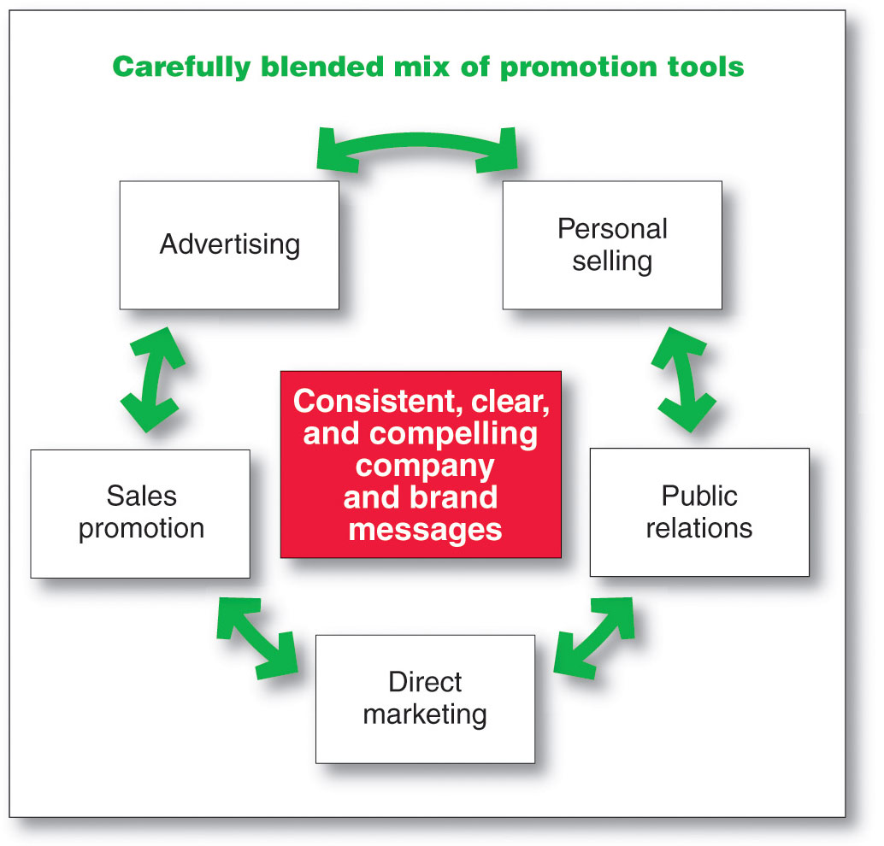
The Promotion Mix
Major Promotion Tools

Slide 4
The Promotion Mix
Major Promotion Tools
Advertising is any paid form of non-personal presentation and promotion of ideas, goods, or services by an identified sponsor
Broadcast
Print
Internet
Outdoor

Slide 5

Advertising
Setting Advertising Objectives
Informative advertising is used when introducing a new product category; the objective is to build primary demand. https://www.youtube.com/watch?v=WuHPqdwltQE
Comparative advertising directly or indirectly compares the brand with one or more other brands.
https://www.youtube.com/watch?v=yOSu_WKkt3w
Persuasive advertising is important with increased competition to build selective demand.
https://www.youtube.com/watch?v=yLHs2-94pvI
Reminder advertising is important with mature products to help maintain customer relationships and keep customers thinking about the product

Slide 6
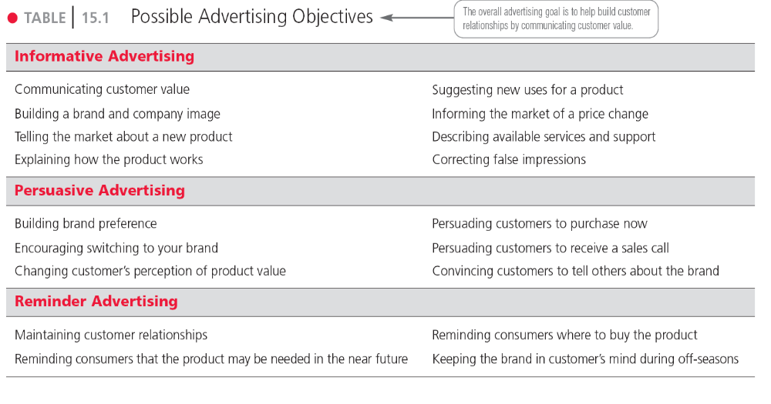
Table 15.1
Possible Advertising Objectives

Slide 7
The Promotion Mix
Major Promotion Tools
Sales promotion is the short-term incentives to encourage the purchase or sale of a product or service
Discounts
Coupons
Displays
Demonstrations

Slide 8

The Promotion Mix
Major Promotion Tools
Public relations involves building good relations with the company’s various publics by obtaining favorable publicity, building up a good corporate image, and handling or heading off unfavorable rumors, stories, and events
Press releases
Sponsorships
Special events
Web pages

Slide 9
The Promotion Mix
Major Promotion Tools
Personal selling is the personal presentation by the firm’s sales force for the purpose of making sales and building customer relationships
Sales presentations
Trade shows
Incentive programs

Slide 10
The Promotion Mix
Major Promotion Tools
Direct marketing involves making direct connections with carefully targeted individual consumers to both obtain an immediate response and cultivate lasting customer relationships—through the use of direct mail, telephone, direct-response television, e-mail, and the Internet to communicate directly with specific consumers
Catalog
Telemarketing
Emailing

Slide 11

Integrated Marketing Communications
The Need for Integrated Marketing Communications
Integrated marketing communications is the integration by the company of its communication channels to deliver a clear, consistent, and compelling message about the organization and its brands

Slide 12
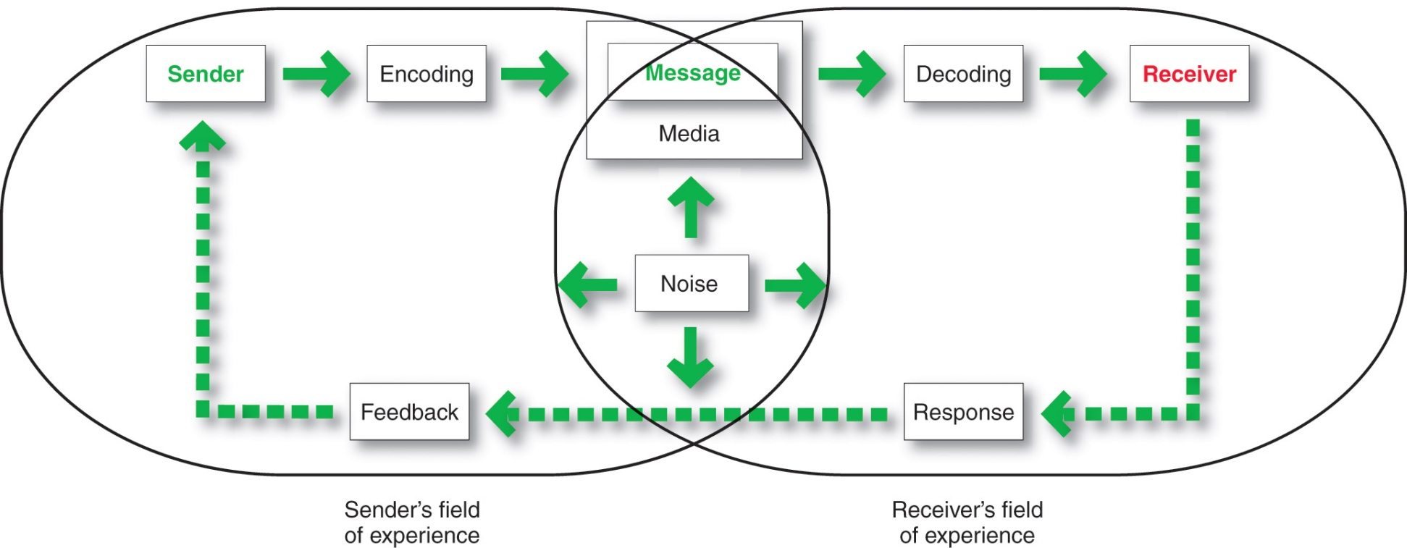
A View of the Communication Process
The Communication Process

Slide 13
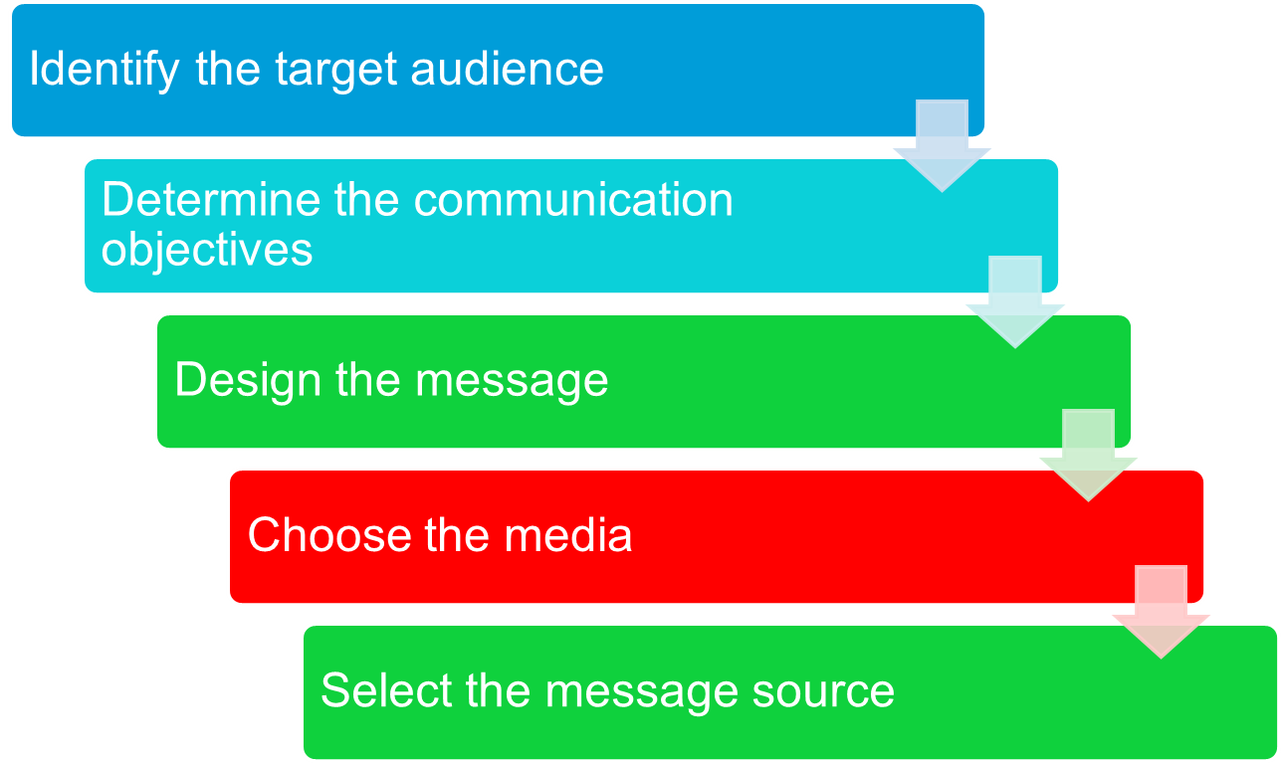
Steps in Developing Effective Marketing Communication Model

Slide 14
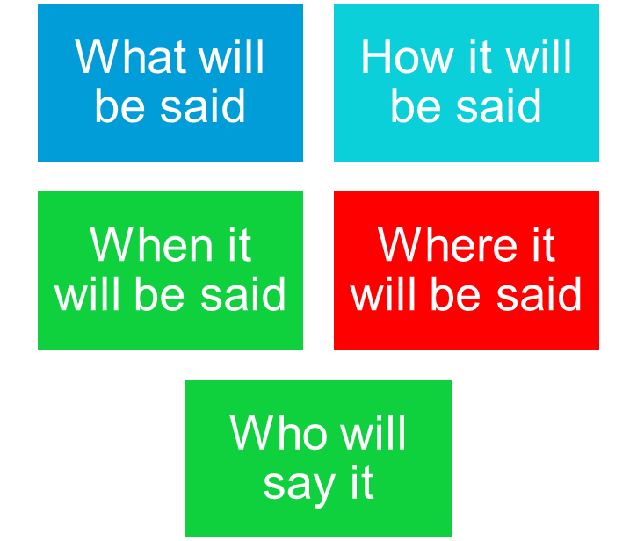
Steps in Developing Effective Communication
Identifying the Target market

Slide 15
Steps in Developing Effective Marketing Communication
Determining the Communication Objectives
Marketers seek a purchase response that results from a consumer decision-making process that includes the stages of buyer readiness
https://www.youtube.com/watch?v=TJ5WFAecylk

Slide 16
Steps in Developing Effective Marketing Communication
Designing a Message
Message Content
Message Structure
Message Format

Slide 17


Steps in Developing Effective Marketing Communication
Designing a Message
AIDA Model
Get Attention
Hold Interest
Arouse Desire
Obtain Action

Slide 18
Steps in Developing Effective Marketing Communication
Designing a Message
Message content is an appeal or theme that will produce the desired response
Rational appeal https://www.youtube.com/watch?v=YrTIa8NmQmI
Emotional appeal
Moral appeal https://www.youtube.com/watch?v=nUPfD_FobwM
https://www.youtube.com/watch?v=fDp5b33KxG0
https://www.youtube.com/watch?v=68Ok8oAqAzI

Slide 19
Steps in Developing Effective Marketing Communication
Designing a Message
Rational appeal relates to the audience’s self-interest
https://www.youtube.com/shorts/W-huVGX1LQs
Emotional appeal is an attempt to stir up positive or negative emotions to motivate a purchase
https://www.youtube.com/watch?v=fesMACX99fU

Slide 20


Steps in Developing Effective Marketing Communication
Designing a Message
Moral appeal is directed at the audience’s sense of right and proper

Slide 21

Steps in Developing Effective Marketing Communication
Choosing Media
Personal communication involves two or more people communicating directly with each other
Face to face
Phone
Mail
E-mail
Internet chat

Slide 22
Steps in Developing Effective Marketing Communication
Choosing Media
Personal communication is effective because it allows personal addressing and feedback
Control of personal communication
Company
Independent experts
Word of mouth

Slide 23

Steps in Developing Effective Marketing Communication
Choosing Media
Personal Communication
Opinion leaders are people within a reference group who, because of their special skills, knowledge, personality, or other characteristics; exerts social influence on others
Buzz marketing involves cultivating opinion leaders and getting them to spread information about a product or service to others in their communities

Slide 24
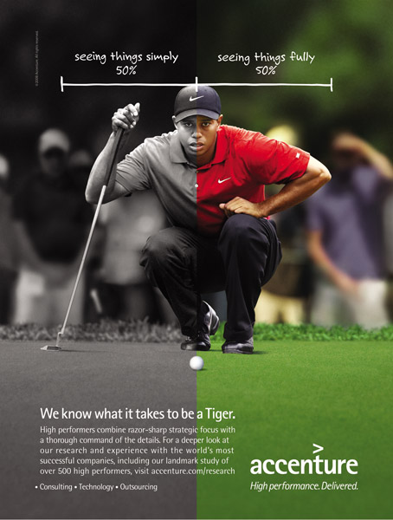
Steps in Developing Effective Marketing Communication
Non-Personal Communication Channels
Non-personal communication is media that carry messages without personal contact or feedback, including major media, atmospheres, and events that affect the buyer directly

Slide 25
Steps in Developing Effective Marketing Communication
Non-Personal Communication Channels
Major media include print, broadcast, display, and online media
Atmospheres are designed environments that create or reinforce the buyer’s leanings toward buying a product

Slide 26
Steps in Developing Effective Marketing Communication
Nonpersonal Communication Channels
Events are staged occurrences that communicate messages to target audiences
Press conferences
Grand openings
Exhibits
Public tours

Slide 27
Steps in Developing Effective Marketing Communication
Selecting the Message Source
The message’s impact on the target audience is affected by how the audience views the communicator
Celebrities
  Athletes
  Entertainers
Professionals
  Health care providers

Slide 28
Steps in Developing Effective Marketing Communication
Collecting Feedback
Involves the communicator understanding the effect on the target audience by measuring behavior resulting from the behavior

Slide 29
Setting the Total Promotion
Budget and Mix
Setting the Total Promotion Budget
Affordable budget method
Percentage Sales method
Competitive Parity method
Objective-task method

Slide 30
Setting the Total Promotion
Budget and Mix
Setting the Total Promotion Budget
Affordable budget method sets the budget at an affordable level
Ignores the effects of promotion on sales

Slide 31
Setting the Total Promotion
Budget and Mix
Setting the Total Promotion Budget
Percentage of sales method sets the budget at a certain percentage of current or forecasted sales or unit sales price
Easy to use and helps management think about the relationship between promotion, selling price, and profit per unit
Wrongly views sales as the cause rather than the result of promotion

Slide 32
Setting the Total Promotion
Budget and Mix
Setting the Total Promotion Budget
Competitive-parity method sets the budget to match competitor outlays
Represents industry standards
Avoids promotion wars

Slide 33
Setting the Total Promotion
Budget and Mix
Setting the Total Promotion Budget
Objective-and-task method sets the budget based on what the firm wants to accomplish with promotion and includes:
Defining promotion objectives
Determining tasks to achieve the objectives
Estimating costs

Slide 34
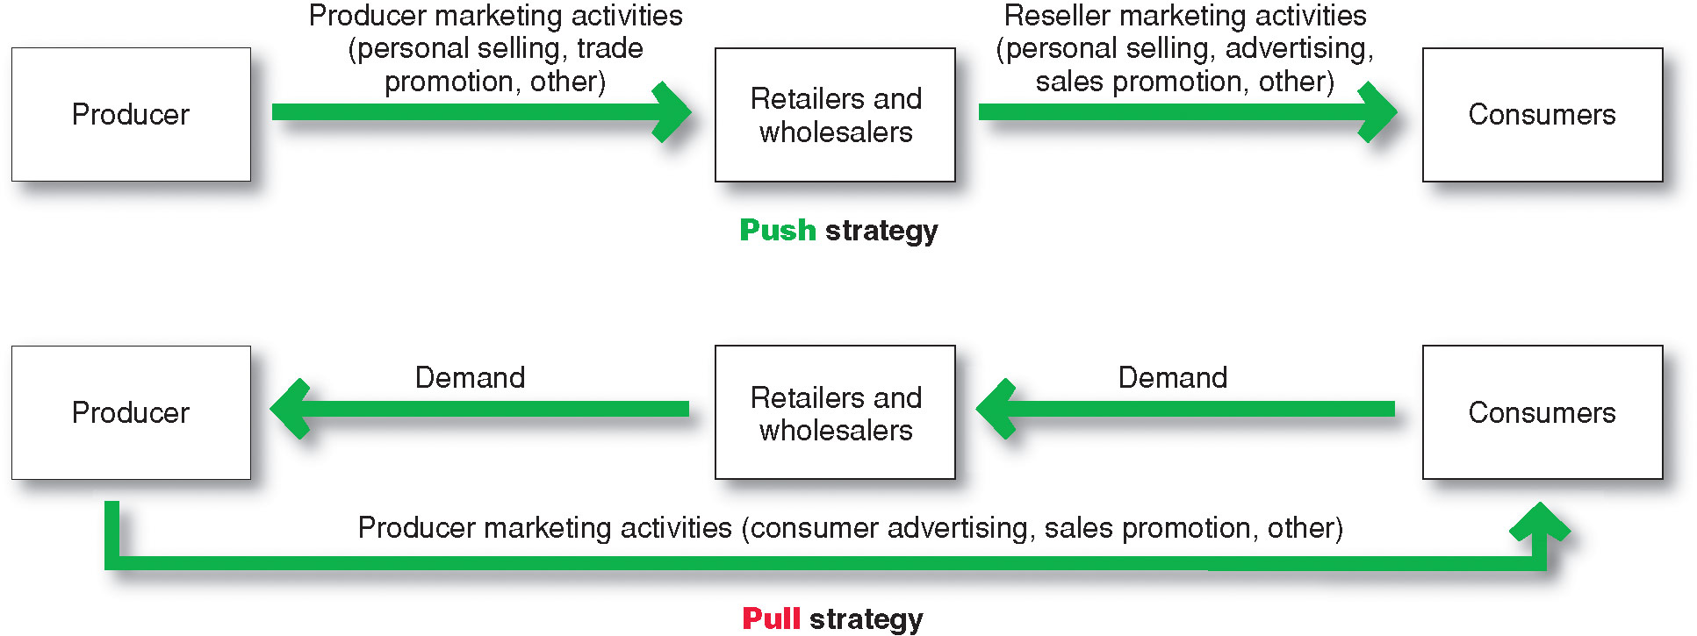
Setting the Total Promotion
Budget and Mix
Promotion Mix Strategies

Slide 35
Setting the Total Promotion
Budget and Mix
Shaping the Overall Promotion Mix
The Nature of Each Promotion Tool
Advertising reaches masses of geographically dispersed buyers at a low cost per exposure, and it enables the seller to repeat a message many times

Slide 36

Setting the Total Promotion
Budget and Mix
Shaping the Overall Promotion Mix
The Nature of Each Promotion Tool
Personal selling is the most effective method at certain stages of the buying process, particularly in building buyers’ preferences, convictions, actions, and developing customer relationships

Slide 37
Setting the Total Promotion
Budget and Mix
Shaping the Overall Promotion Mix
The Nature of Each Promotion Tool
Sales promotion includes coupons, contests, cents-off deals, and premiums that attract consumer attention and offer strong incentives to purchase, and can be used to dramatize product offers and to boost sagging sales

Slide 38
Setting the Total Promotion
Budget and Mix
Shaping the Overall Promotion Mix
The Nature of Each Promotion Tool
Public relations is a very believable form of promotion that includes news stories, features, sponsorships, and events
Direct marketing is a non-public, immediate, customized, and interactive promotional tool that includes direct mail, catalogs, telemarketing, and online marketing

Slide 39
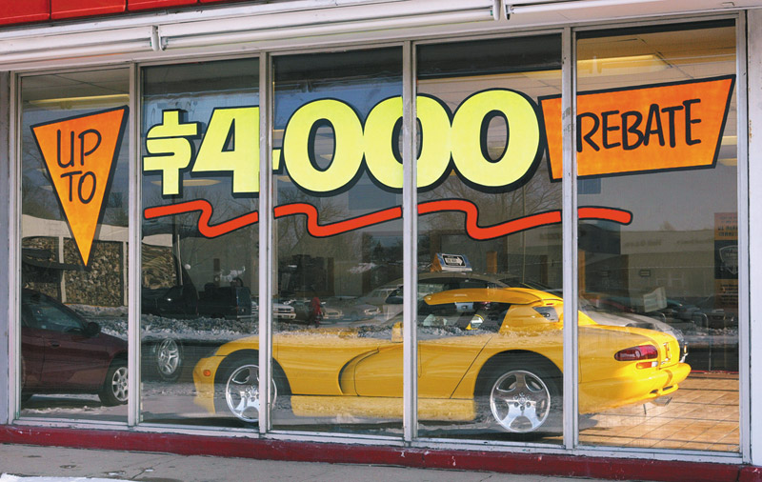
Socially Responsible Marketing Communication
Communicate openly and honestly with consumers and resellers
Avoid deceptive or false advertising
Avoid bait-and-switch advertising
Conform to all federal, state, and local regulations
Follow rules of “fair competition”
Do not offer bribes
Do not attempt to obtain competitors’ trade secrets
Do not disparage competitors or their products

